Slide 1
ENTITY RELATIONSHIP DIAGRAM (ERD)

Slide 2
Key Definitions
Data model (Conceptual Data Model)
  A formal way of representing the data that are used and created by a business system.
  Shows the people, places and things about which data is captured and the relationships among them.
Logical data model
  Shows the organization of data without indicating how it is stored, created, or manipulated.

Slide 3
Key Definitions
Physical data model
  Shows how the data will actually be stored in databases or files.
Normalization is the process
  Analysts use to validate data models.
  Data models should balance with process models.

Slide 4
What Is an ERD?
A picture showing the information created, stored, and used by a business system.
Entities generally represent similar kinds of information.
Lines drawn between entities show relationships among the data.
High level business rules are also shown.

Slide 5
Using the ERD to Show Business
Rules
Business rules are constraints that are followed when the system is in operation.
ERD symbols can show when one instance of an entity must exist for an instance of another to exist.
  A doctor must exist before appointments for the doctor can be made.

Slide 6
Using the ERD to Show Business
Rules
ERD symbols can show when one instance of an entity can be related to only one or many instances of another entity.
  One doctor can have many patients; each patient may have only one primary doctor.
ERD symbols show when the existence of an entity instance is optional for a related entity instance.
  A patient may or may not have insurance coverage.

Slide 7
An ERD Example

Slide 8
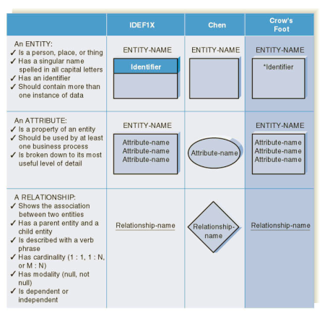
ERD Elements

Slide 9
Entity
A person, place, event, or thing about which data is collected.
Must be multiple occurrences to be an entity.
  Example: If a firm has only one warehouse, the warehouse is not an entity. However, if the firm has several warehouses, the warehouse could be an entity if the firm wants to store data about each warehouse instance.

Slide 10
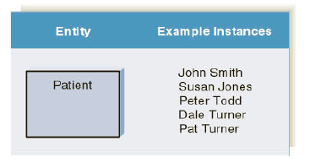
Entities and Instances

Slide 11
Attributes
Information captured about an entity.
Only those used by the organization should be included in the model.
Attribute names are nouns.
Sometimes entity name is added at the beginning of the attribute name for clarity.

Slide 12
Identifiers
One or more attributes can serve as the entity identifier, uniquely identifying each entity instance.
Concatenated identifier consists of several attributes.
An identifier may be ‘artificial’, such as creating an ID number.
Identifiers may not be developed until the Design Phase.

Slide 13
Choices for Identifiers

Slide 14
Generalization - Specialization
Generalization
  It is a bottom-up approach in which two or more entities can be generalized to a higher level entity if they have some attributes in common.
  For Example, STUDENT and FACULTY can be generalized to a higher level entity called PERSON.
Specialization
  It is a top-down approach where higher level entity is specialized into two or more lower level entities.
  For Example, EMPLOYEE entity in an Employee management system can be specialized into DEVELOPER, TESTER etc.

Slide 15
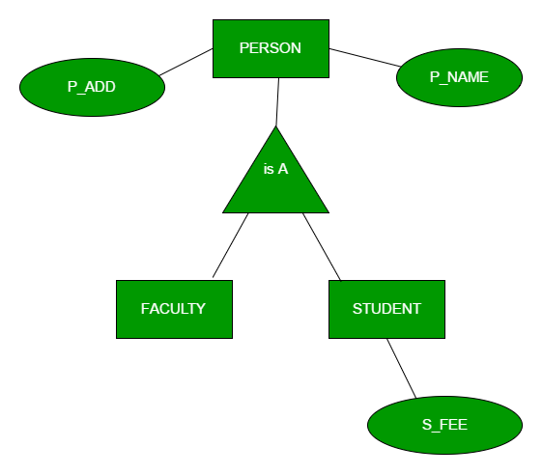

Slide 16
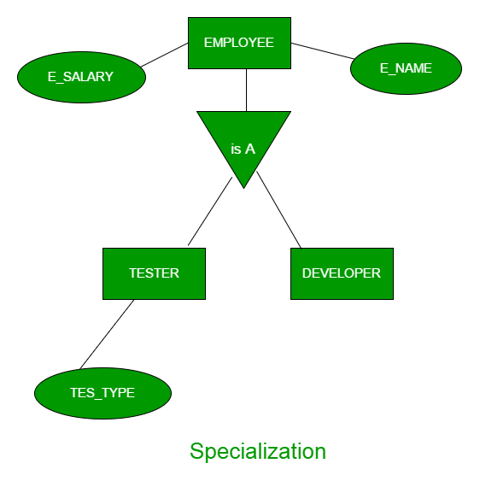

Slide 17
Relationships
Associations between entities.
The first entity in the relationship is the parent entity; the second entity in the relationship is the child entity.
Relationships should have active verb names.
Relationships go in both directions.

Slide 18
Cardinality
Refers to the number of times instances in one entity can be related to instances in another entity.
  One instance in an entity refers to one and only one instance in the related entity (1:1).
  One instance in an entity refers to one or more instances in the related entity (1:N).
  One or more instances in an entity refer to one or more instances in the related entity (M:N).

Slide 19
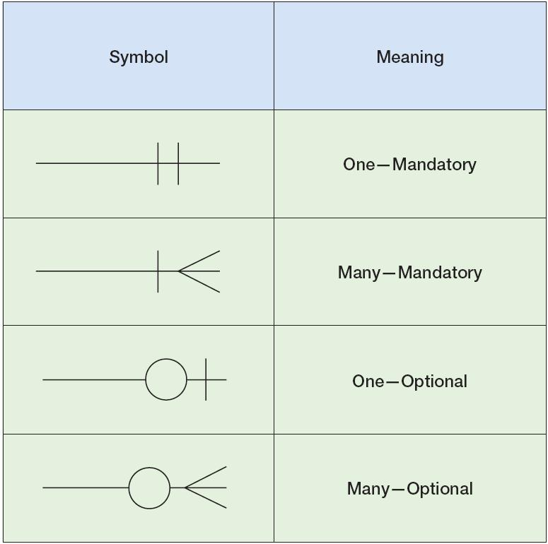

Slide 20
Modality
Refers to whether or not an instance of a child entity can exist without a related instance in the parent entity.
Not Null means that an instance in the related entity must exist for an instance in another entity to be valid.
Null means that no instance in the related entity is necessary for an instance in another entity to be valid.

Slide 21


Slide 23
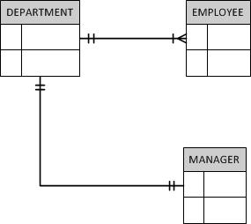

Slide 24
Recursive Relationship
It’s a relationship with the same entity.
  For example, an employee may act as a supervisor for one or more employees, while an employee may be supervised by an employee (it’s one-to-many relationship).

Slide 25
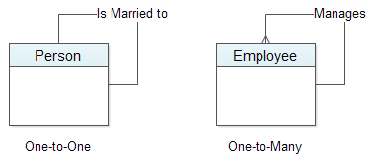

Slide 26
Weak Entity
A weak entity is simply an entity where it’s existence depends on another entity.
A weak entity has what’s called a “partial key”. It’s one or more attributes that uniquely identify a weak entity for a given owner entity.

Slide 28
Attribute relationship
Relationship can have attributes.
Weak entity is used to represent attribute relationship.

Slide 30
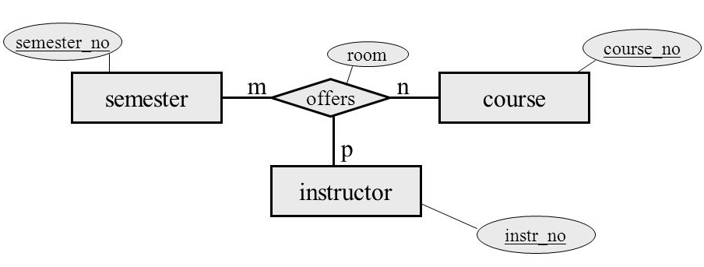
N-ary relationship

Slide 31
N-ary relationship
Weak entity is also used to represent n-ary relationship.

Slide 32
Conversion of ER Diagram to Relational model

Slide 33
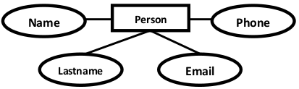
Mapping (regular/strong) entity
For each strong entity set create a new relational independent table that includes all attributes as column.
Persons( personid , name, lastname, email )

Slide 34
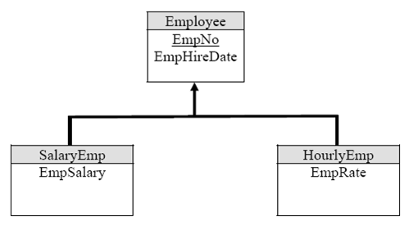
Converting Generalization Hierarchies
Convert each entity of a generalization hierarchy into a table.
The only column appearing that are different from attributes in the associated ERD is the inherited Primary Key.
Employee (EmpNo, EmpHireDate)
SalaryEmp (EmpNo, EmpSalary)
HourlyEmp (EmpNo, EmpRate)

Slide 35
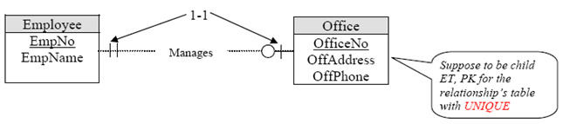
Mapping 1:1 Relationship
For a 1:1 Relationship between two entities S and T. Choose one of the relations, Example - S and include as foreign key in S the primary key of T.
It is better to choose on entity total participation on S and include descriptive attribute.
Office (OfficeNo, OffAddress, OffPhone)
Employee (EmpNo, EmpName, OffNo)

Slide 36
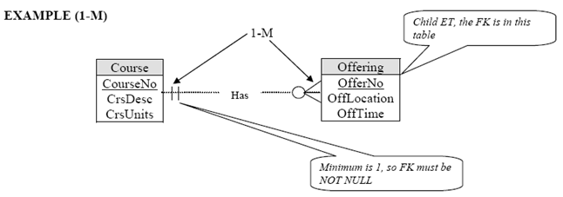
Mapping 1:N Relationship
For 1:N relationship identify the entity S on N side of the relationship, include a foreign key in S the Primary key of relation T also include Discipline attributes of 1:N attribute of S.
Course (CourseNo, CrsDesc, CrsUnits)
Offering (OfferNo, OffLocation, OffTime, CourseNo)

Slide 37
Mapping N:N Relationship
For each M:N relationship
  Create a new relational table include in the new relation,
  The primary key of the participating entities as a well as descriptive attributes,
  The primary key of the table will be the combination of primary keys of participating entities.
STUDENT (StudentID)
COURSE (CourseID)
EnrollIn (StudentID, CourseID)

Slide 38
Mapping weak entity
Convert every weak entity set into a table where
  we take the discrimination attribute of the weak entity set and takes the primary key of the strong entity set as a foreign key.
  and then declared the combination of discriminator attribute and foreign key as a primary key.
CITY (CITY_NAME)
DISTRICT (DISTRICT_NAME, CITY_NAME)

Slide 39
VALIDATING AN ERD

Slide 40
Normalization
Technique used to validate data models.
Series of rules applied to logical data model to improve its organization.
Three normalization rules are common.

Slide 41
Normalization Steps

Slide 42
First Normal Form (1NF)

Slide 43
Second Normal Form (2NF)
If an entity has a concatenated identifier, look for attributes that depend only on part of the identifier. If found, remove to new entity.

Slide 44
Third Normal Form (3NF)
Look for attributes that depend only on another non-identifying attribute. If found, remove to new entity. Also remove any calculated attributes.

